Slide 1
Prudentia Social Media in Blockchain
Harun Alperen Toktaş : 21727795 İsmaİl Ateş : 21626953 Oktay Uğurlu : 21627725 Muhammed Saİd Kaya : 21627428

Slide 2

Traditional Social Media
In the digital age, the use of the internet and social media platforms, where all data is stored in a central unit, brings many conveniences to our lives, as well as some drawbacks and problems..

Slide 3

Traditional Social Media Problems
Data Privacy
Collecting Data in a Single Center
Social Engineering
Fake News
Transparency
Unified Media Portal
Tokenizing Virtual Goods
Facebook Data Sharing Scandal

Slide 4

Blockchain Based Social Media Platforms
Blockchain, by its nature, has a technology that is far from the central structure (where all information is collected and stored in one place), and that can provide security and privacy. This is why blockchain is the technology that plays a key role in solving the problems that traditional social media has inherently.

Slide 5
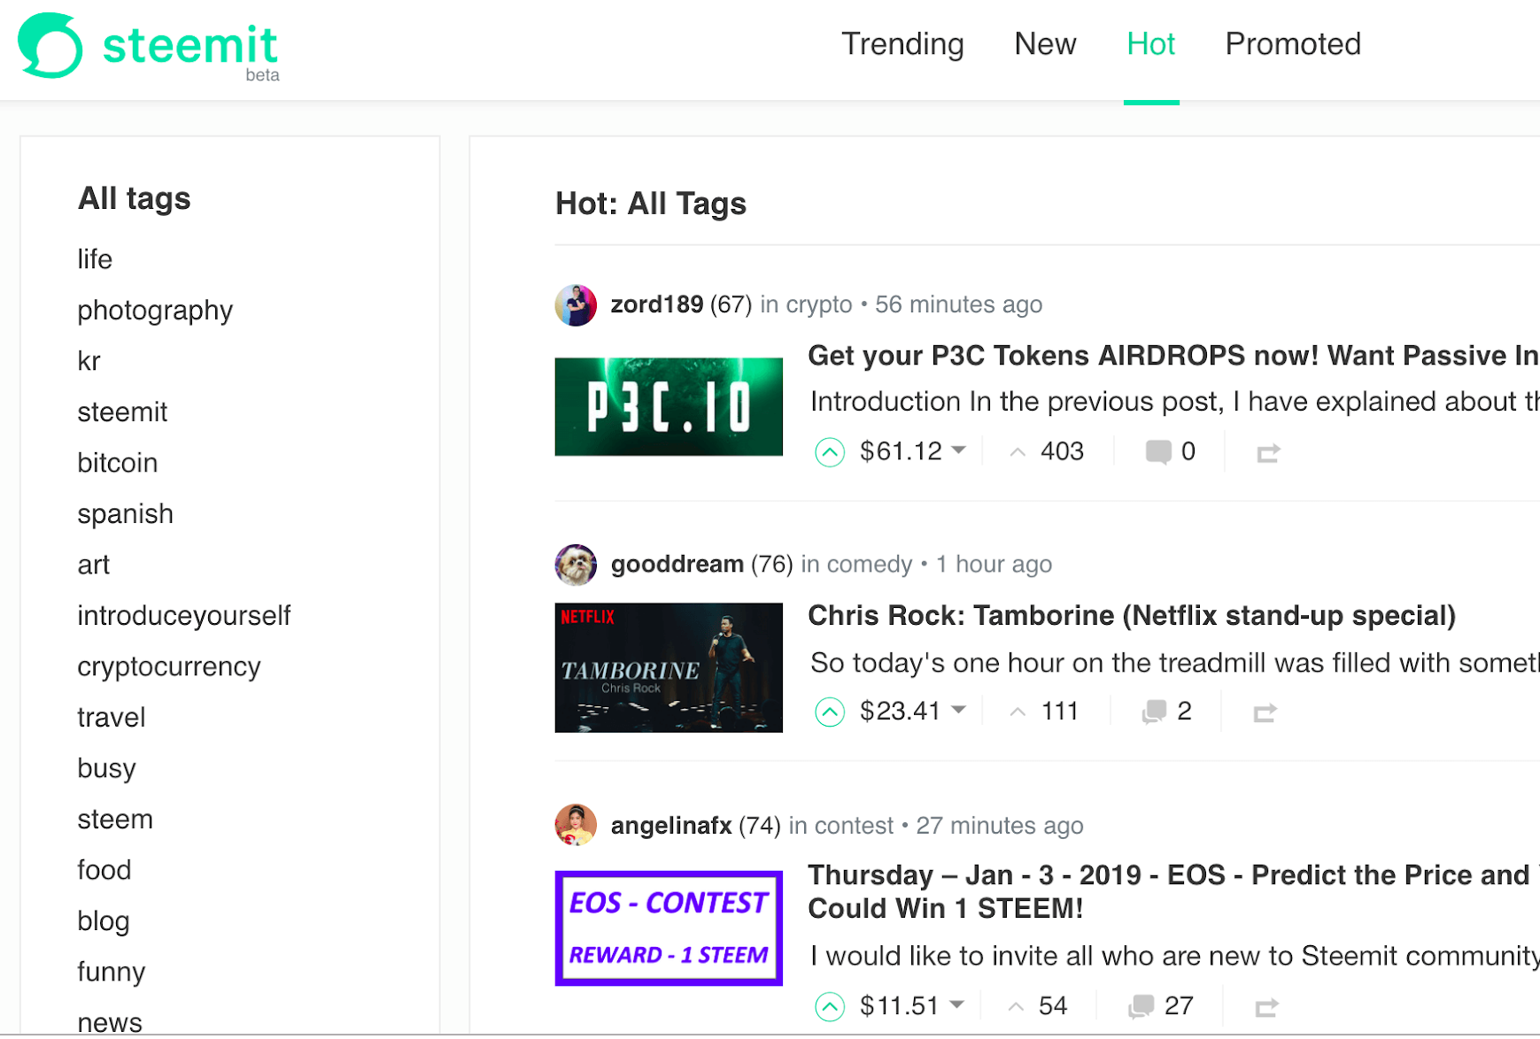
Steemit
Steemit is the first blockchain based social media structure that is not connected to a single center, rewards its users according to the interest of the content they produce, and stores all kinds of information of its users using blockchain-based technology.

Slide 6


Steemit(Cont.)
Advantages
Service As a Monetizer.
Quality Content is the Best.
Decentralized Structure.
Delegated Proof of Stake
Disadvantages
The effect of large shareholders
Hard to Exchange
Bot Attacks

Slide 7
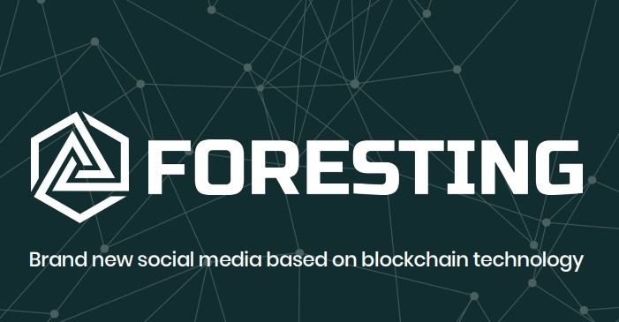
Foresting
The foresting project is one of the popular examples of decentralized social media which is started in early 2018. The system serves on the Ethereum blockchain. The Foresting Network comprises three different blockchain services which are Foresting Platform, Foresting Bank, and Foresting Lab.

Slide 8
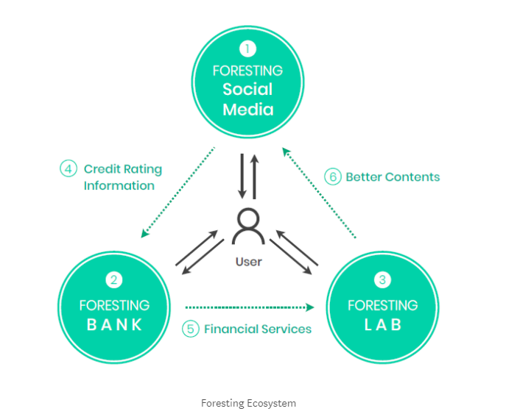
Foresting(Cont.)
The system consist in 3 platform:
Foresting Bank
Foresting Lab
Foresting Social Media

Slide 9
Foresting(Cont.)
Advantages
Peer to Peer Transaction
Optimized Consensus Algorithms
Advertisement Pool
Limited Transactions
Disadvantages
Load Balance Harms Decentralization
No Censorship
No Private Chat Messaging

Slide 10
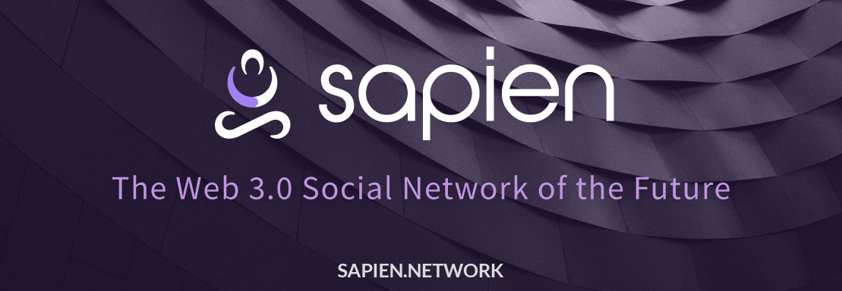
Sapien
Sapien is a partial blockchain-based communication platform that holds millions of content producers and people who are in the system and consume these contents together and transfer certain rewards, placing emphasis on democracy and liberation. It is based on the Ethereum Platform, so it uses Proof of Stake(Casper) consensus mechanisms.

Slide 11
Sapien(Cont.)
Advantages
Highly customizable
Data Transparency and Privacy.
Token exchange
Disadvantages
Partial Decentralized Platform
Lots of verification (Google recaptcha, SMS, E-Mail) for Bots
Limited number of branches.

Slide 12

Minds
Minds is a social media platform that is open source and decentralized. For contributions to the project, users are compensated with Minds tokens. Minds seeks to create a new model for content creators to take back their rights, income and social influence from the internet.

Slide 13
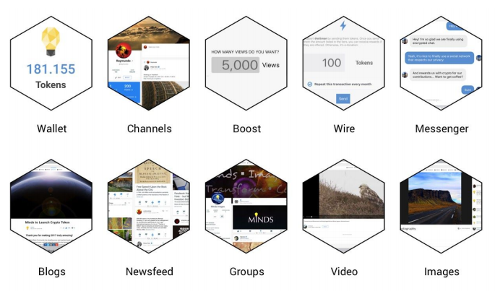
Minds(Cont.)
The system consist in 5 platform:
Boost
Wire
Plus
Hosting
Affiliate Rewards

Slide 14
Minds(Cont.)
Advantages
ERC-20 ethereum based on token
Open source
Peer-to peer payment system
End-to-end encrypted messaging
Ideologically neutral
No filtering
Disadvantages
Bot attacks
Verification systems
Gaining rewards

Slide 15

Proposed Model
As we have just mentioned, decentralized systems have certain advantages as well as shortcomings. We take the good sides of the system we have created, improve the missing parts and propose a new model. Let's explain our system in parts.

Slide 16
Our system’s components
Life Cycle of a Post(Any content)
Reward Distribution
Consensus Algorithm
Prudent Token
Private Transactions
Protection from Sybil Attack

Slide 17
Every user can create.
Every user can see any post.
Post Categorization
Voting on Consensus Algorithm
The life of content is 24 hours.
Harmful content will punish
Users can rate with upvote and downvote
Life Cycle of a Post(Any content)

Slide 18
Reward Distribution
Voters(15 min 20%, 15-30 min 10% prize)
Commenter(total 10%)
Producer(fee)
Creator(Remaining Reward)

Slide 19
Consensus Algorithm
Content Filtered by AI and Goes to Voters
Producer candidates must have invested money in the system
The registration time of the producer candidate to the system
The number of transactions carried out by the producer candidate
The number of a producer candidate being voter in the system

Slide 20

Prudent Token
Created with the ERC-20 protocol
IDEX exchange

Slide 21

Private Transactions
Using the transaction manager as in Quorum
Prevented from reading this data, collision resistance with a hash algorithm

Slide 22

Protection From Sybil Attack
Deposits from users
Users have to stake a certain amount of tokens

Slide 23
Conclusion
In this study, traditional social media and blockchain-based social media were compared and the existing blockchain-based models were analyzed. In line with this analysis, a new model has been proposed to improve existing systems.

